Slide 1

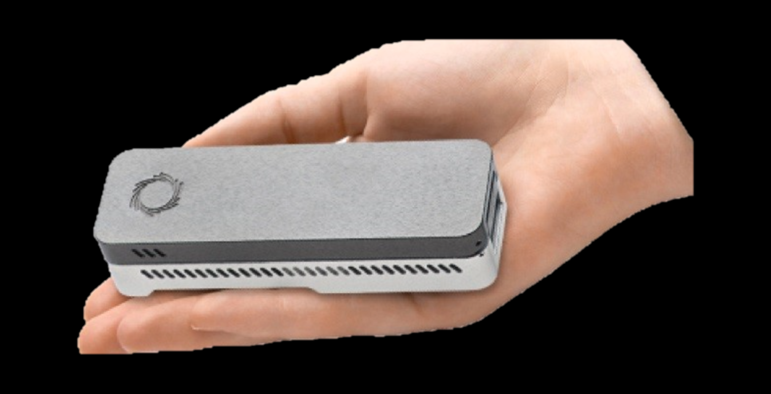
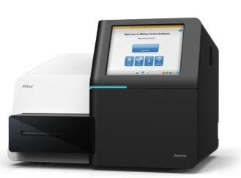
Microbial Genomics Theory and Practice
Professor Mark Pallen

Slide 2
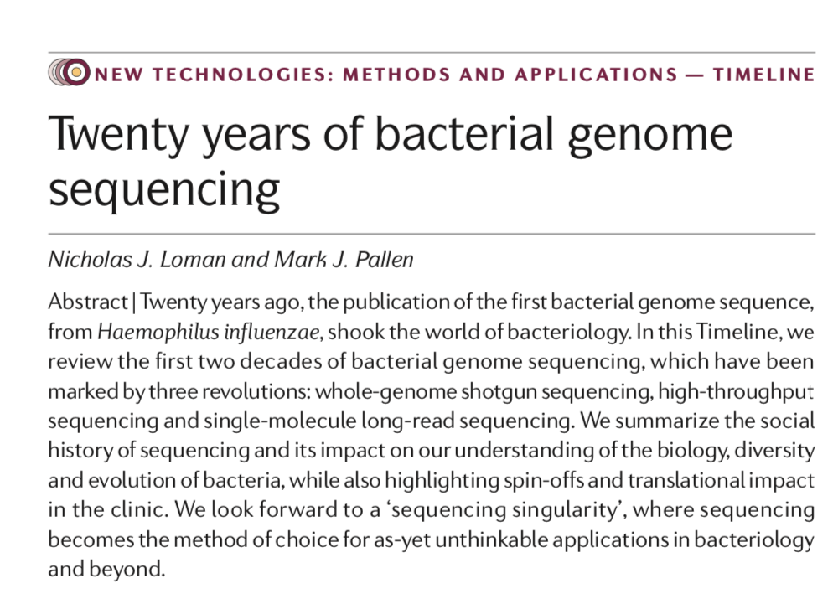
A few questions…
How big is a bacterial genome?
How do bacterial genomes differ from the human genome sequence?
What can you learn from a bacterial genome sequence?
Loman and Pallen (2015)
https://www.nature.com/articles/nrmicro3565

Slide 3
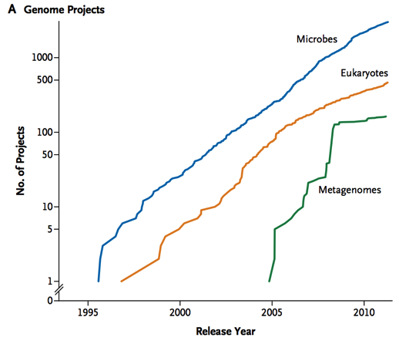
Bacterial Genomics The Golden Era: 1995-2007
Phase 1
Genome sequences from all significant bacterial pathogens of humans, animals and plants
Insights into pathogen biology
Phase 2
Multiple genomes from same species
Insights into genomic diversity

Slide 4
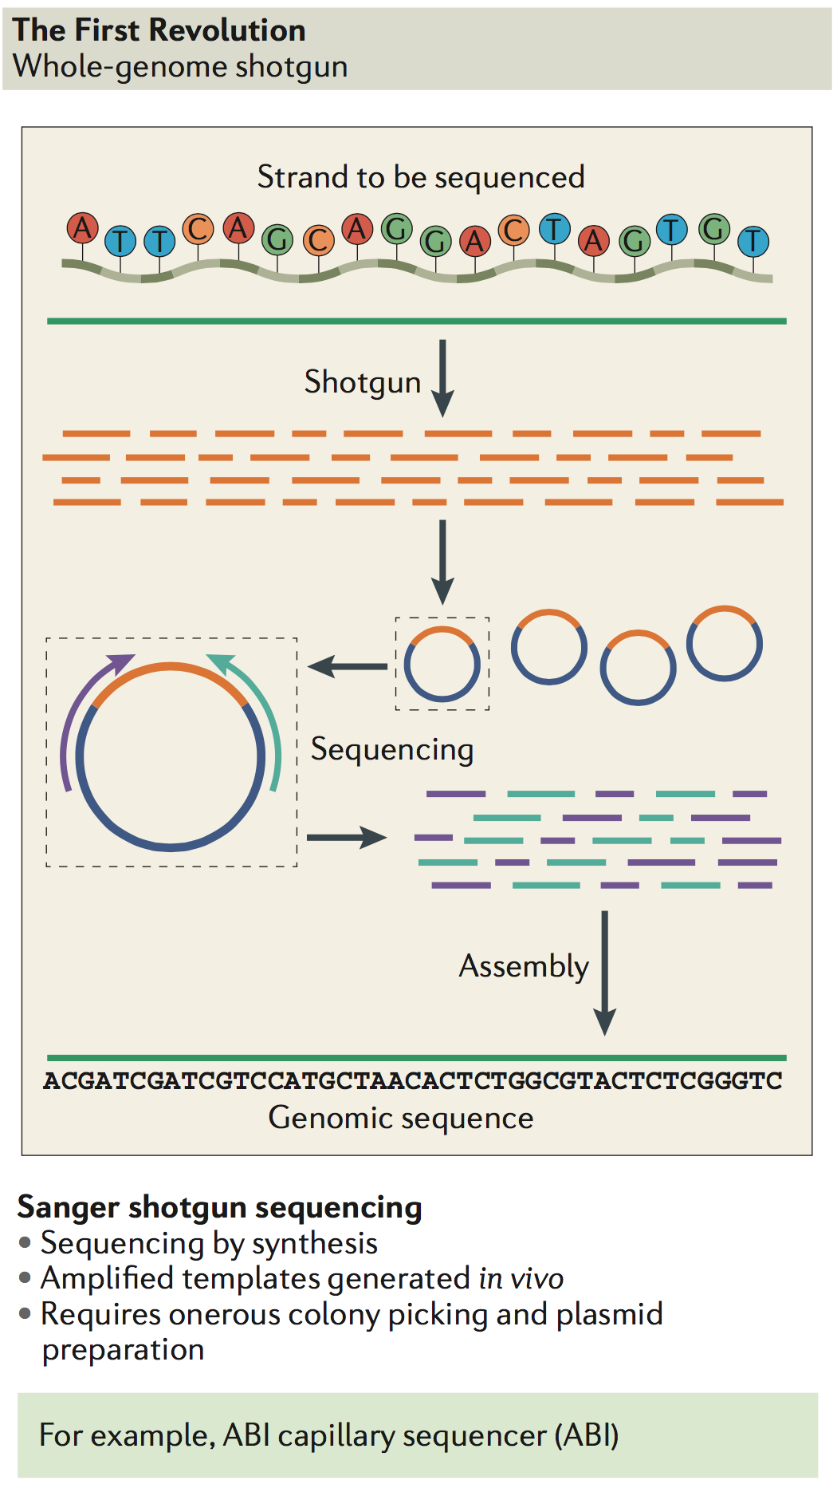
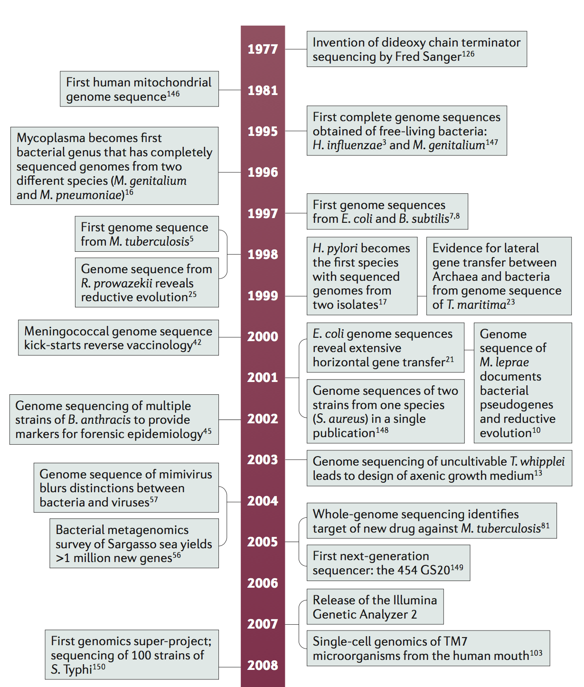
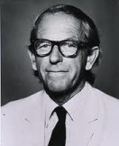


Slide 5
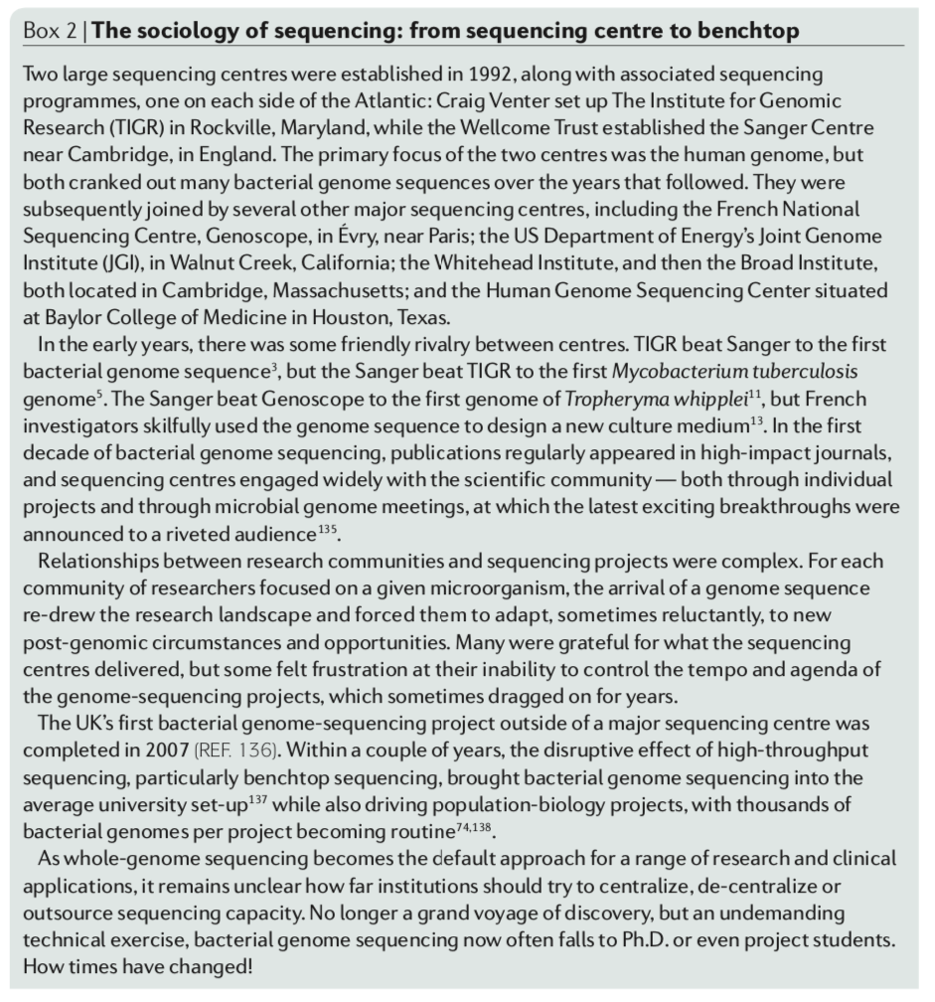

Slide 6
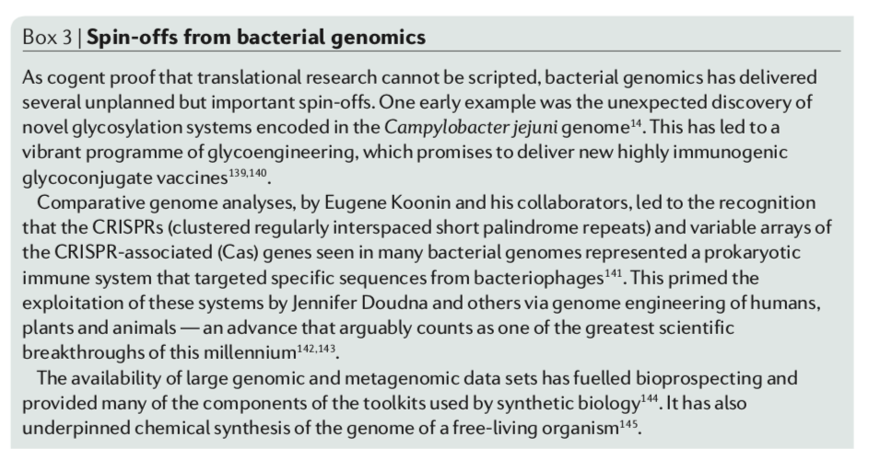

Slide 7
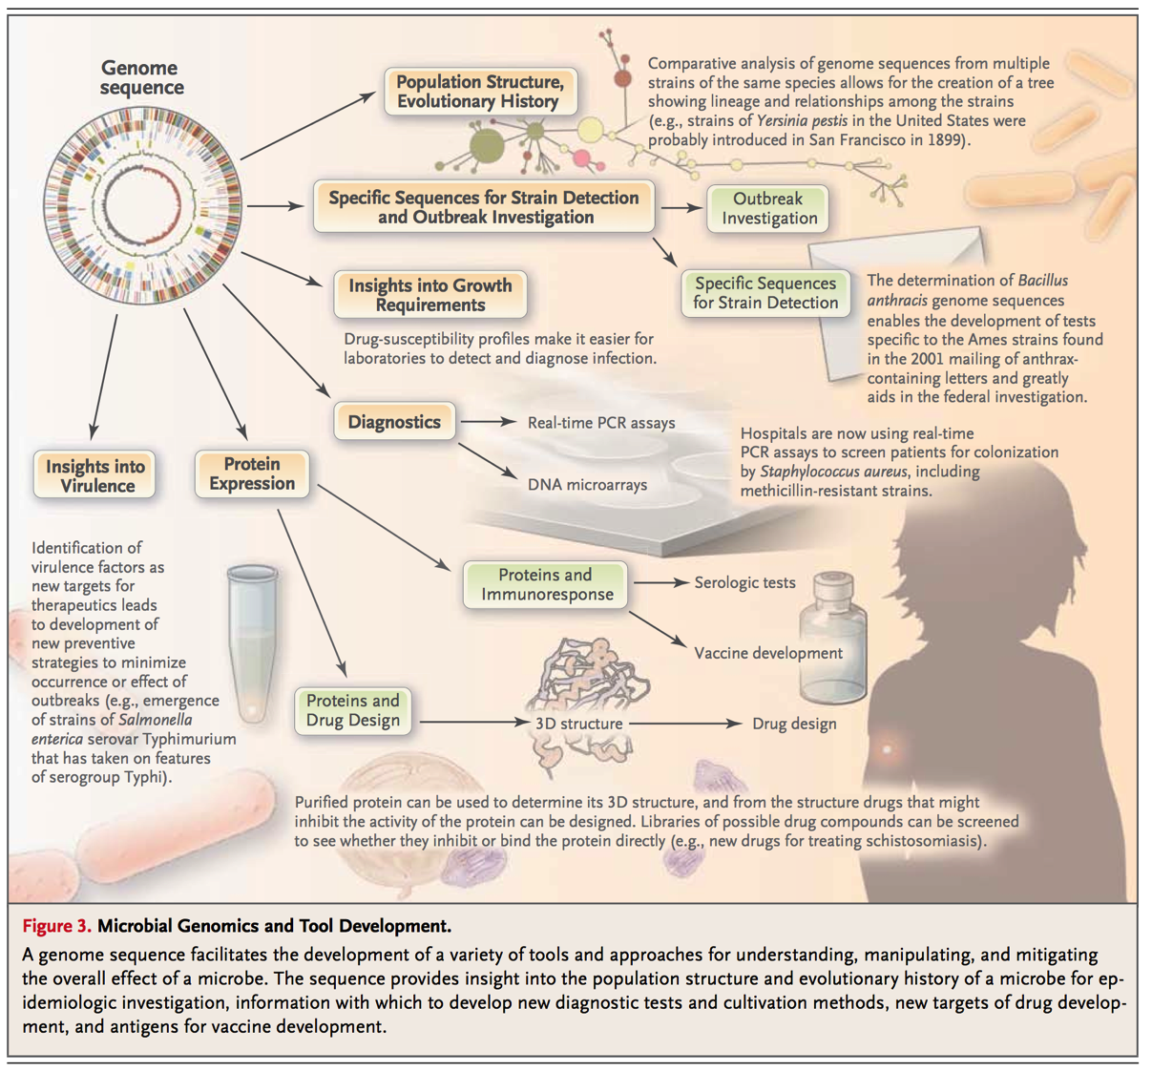
https://www.nejm.org/doi/full/10.1056/nejmra1003071

Slide 8
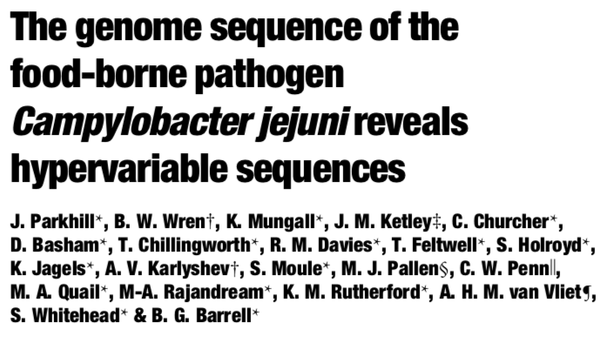
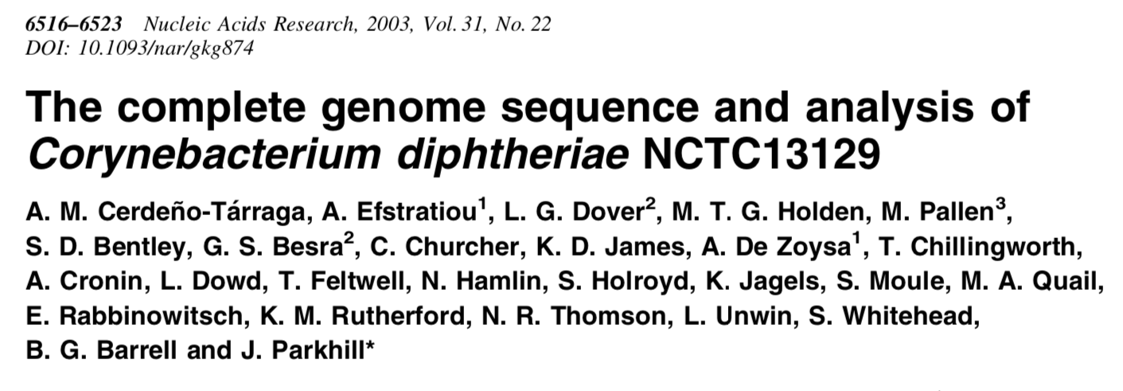
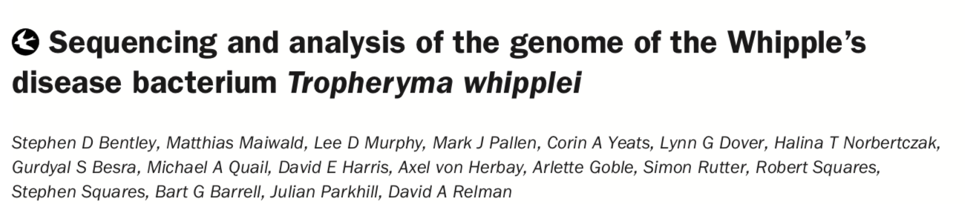

Slide 9
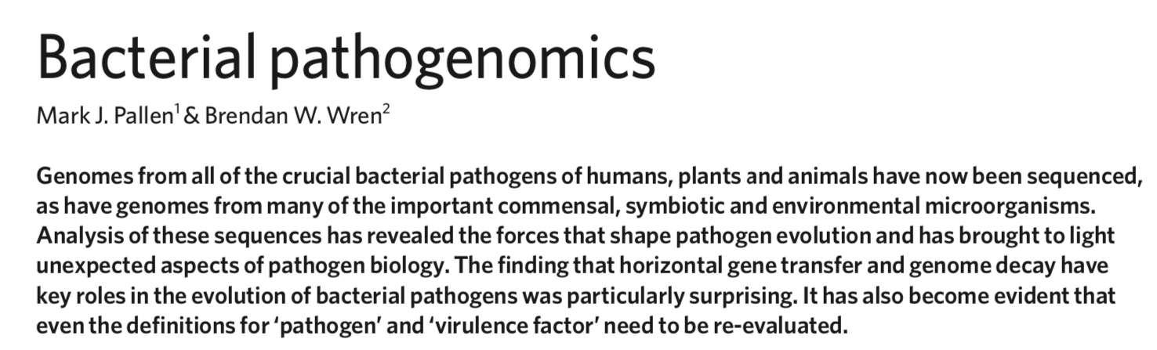
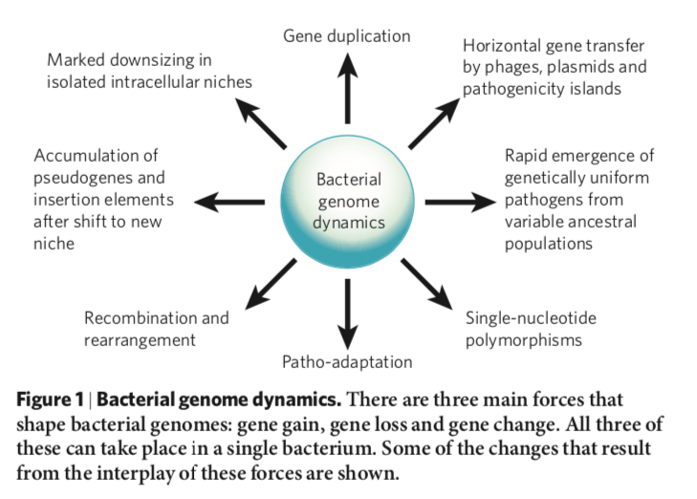
^{NATURE} ^{Vol 449} ^{18 October 2007}
^{doi:10.1038/nature06248}

Slide 10
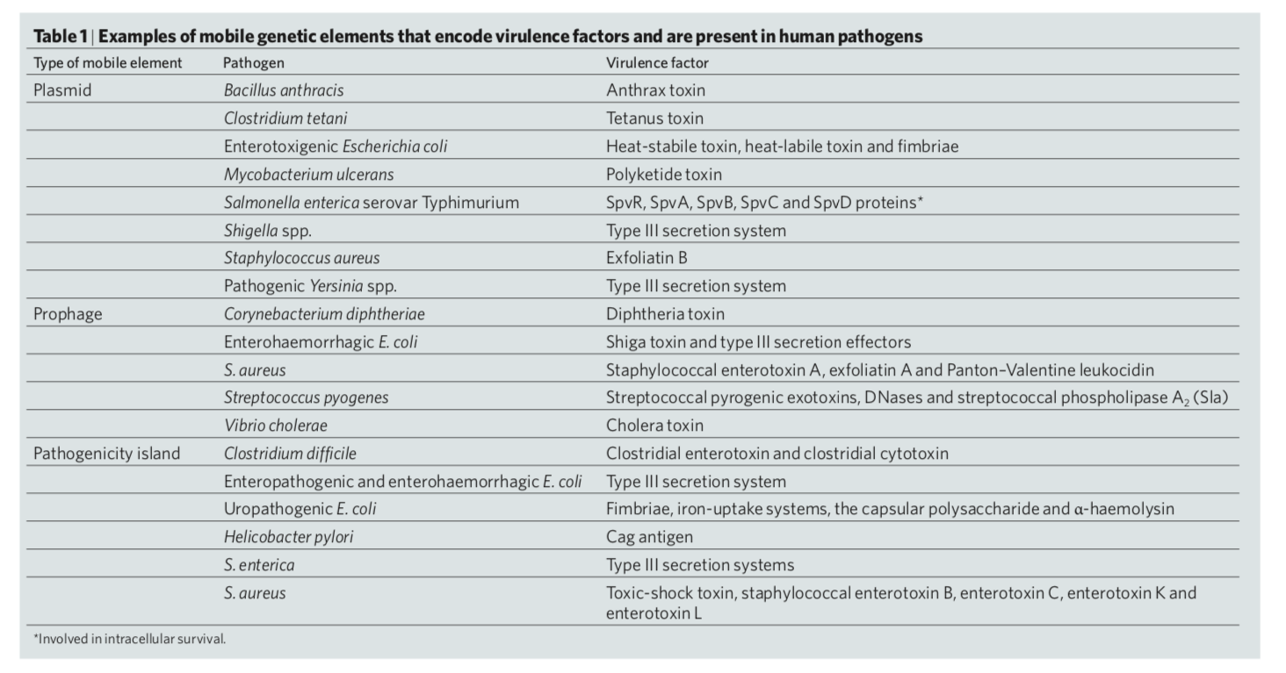

Slide 11
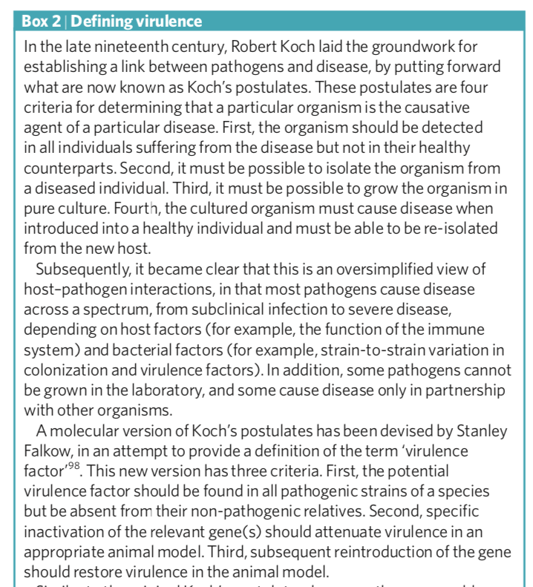
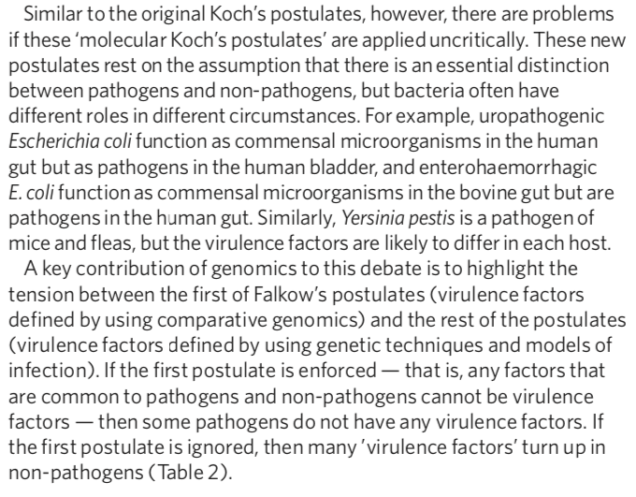

Slide 12
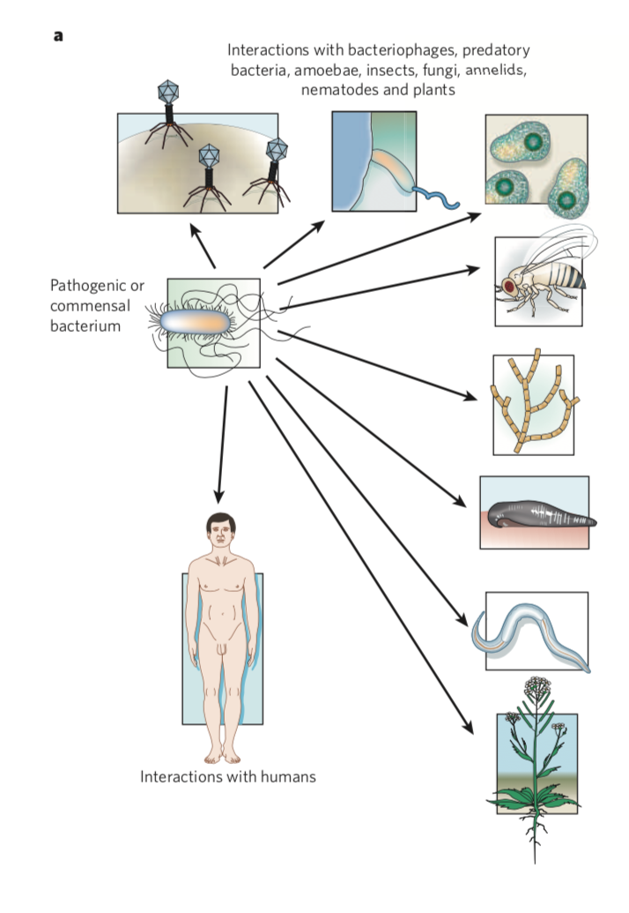
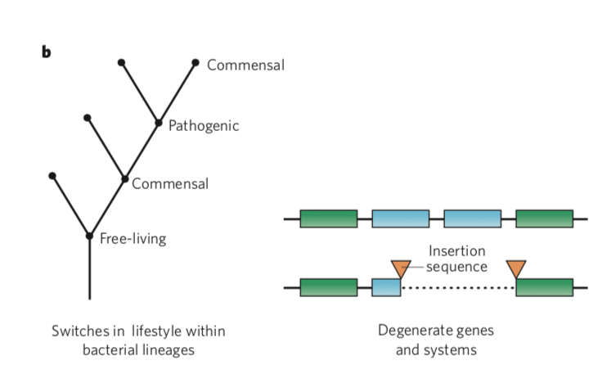

Slide 13
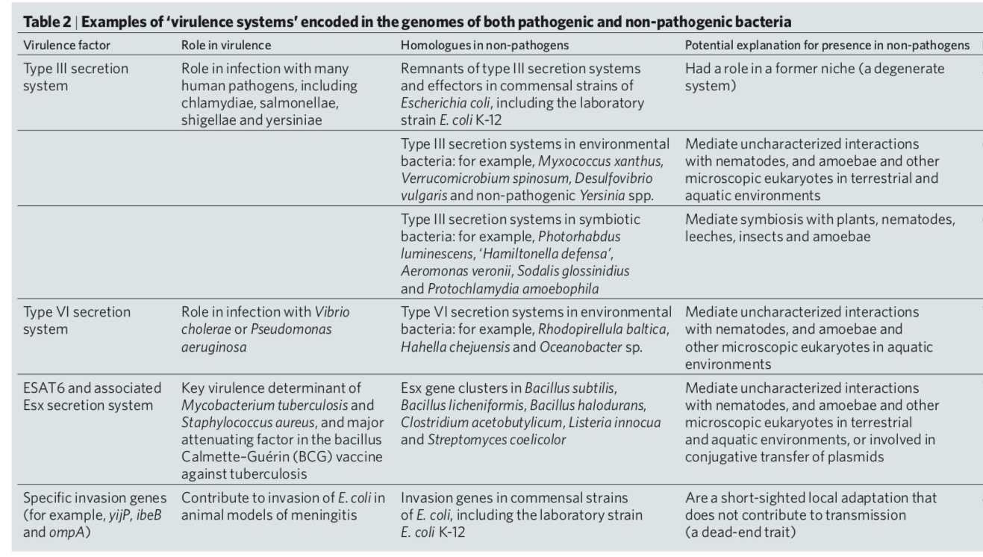

Slide 14
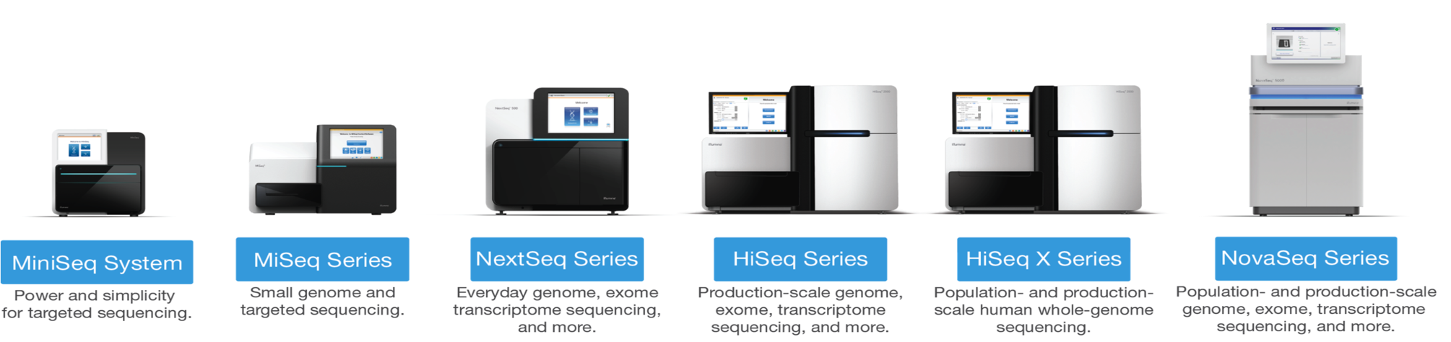
High-throughput Sequencing from 2007 onwards
>1000x faster, >1000x cheaper!
A disruptive technology
Bench-top sequencing easy, quick and cheap enough to have an impact on real-world clinical problems
Illumina short read sequencing

Slide 15
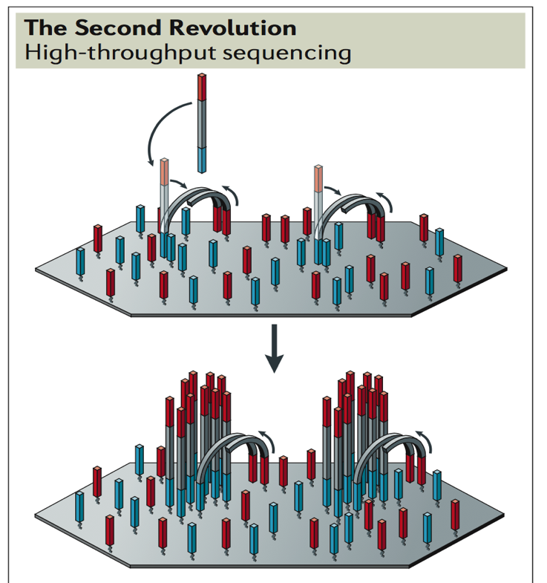
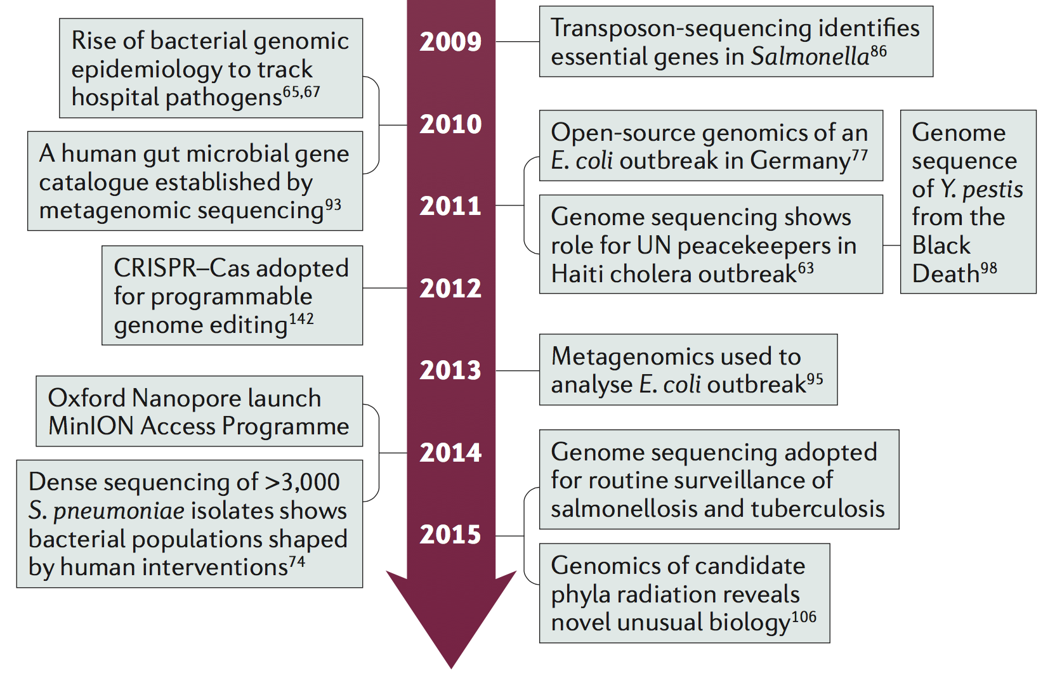
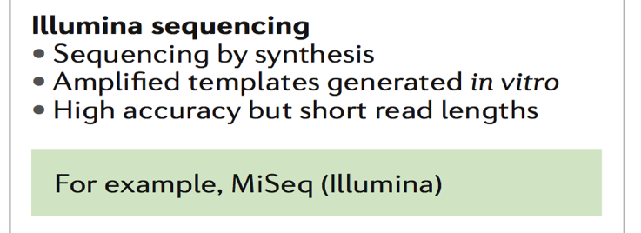
Fundamentally new approaches
Solid-phase amplification of clonal templates in “molecular colonies”
Massive increase in number of “clones” compensates for shorter read length

Slide 16
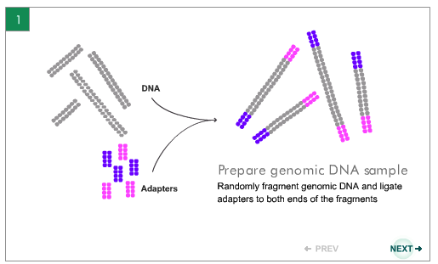
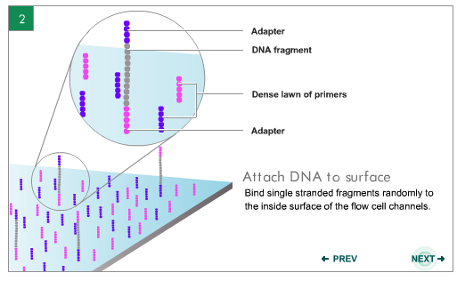
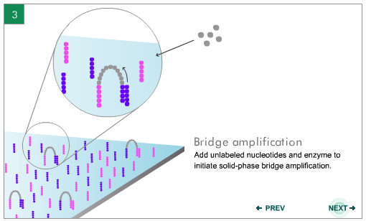
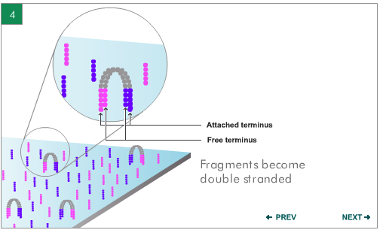
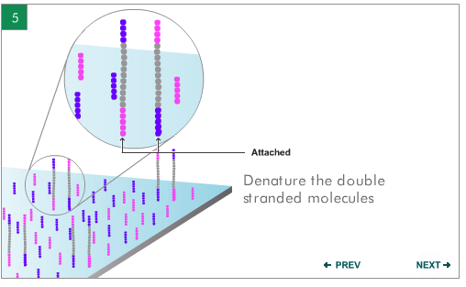
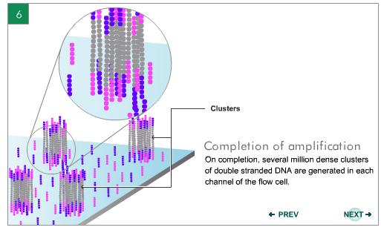
Illumina Sequencing

Slide 17
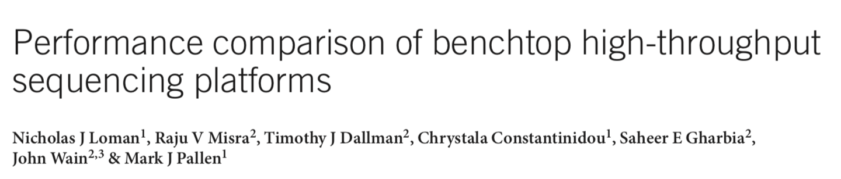
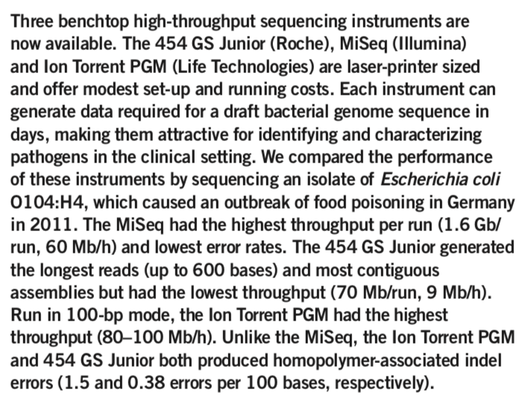

Slide 18
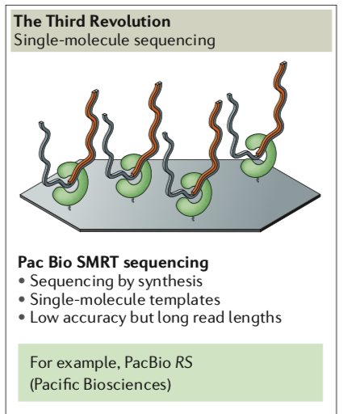
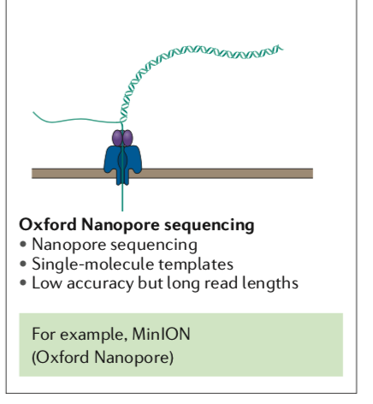

Slide 19


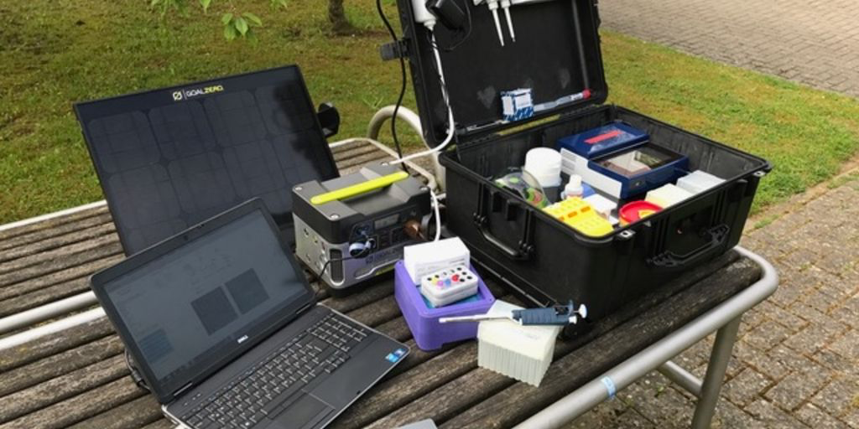
https://www.youtube.com/watch?v=3amtw4zi0B8

Slide 20
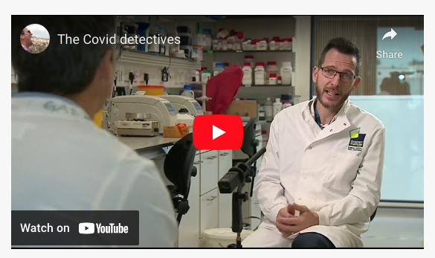
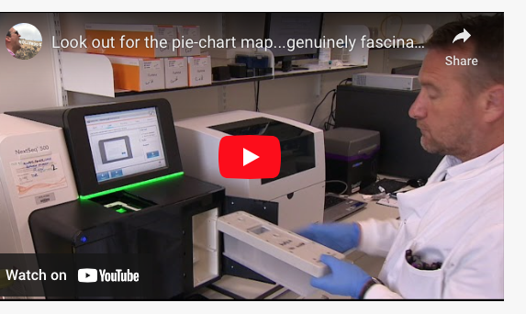

https://quadram.ac.uk/targets/coronavirus-covid-19/

Slide 21
General features of genomes
Microbial
Human
Small WSIWYG genomes (Mbp)
Gene density high (>90%)
intergenic regions short
very little repetitive or non-coding DNA
Introns very rare
Protein-coding genes (CDS) short (~1kbp)
Operons with promoters just upstream
Fewer non-coding RNAs
Very large genomes (Gbp)
Gene density low
Only 25% is genes
Introns mean only1% codes
Genes can span ≥30 kbp
Genes have ~3 transcripts
Splicing and splice variants
Promoter regions distant from gene

Slide 22
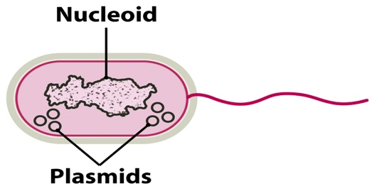
Bacterial genome organisation
Chromosomes
Plasmids
Most commonly single circular chromosome (always DNA)
BUT many species have linear chromosome(s) (e.g. Borrelia, Streptomyces, Rhodoccus)
BUT a few species with two chromosomes (e.g. Vibrio cholerae)
Can be mix of circular and linear (e.g. Agrobacterium tumefaciens, B. burgdoferi)
Independent autonomous replicon, can be circular or linear
may integrate into chromosome
copy number varies 1 to 10s
often carry non-essential genes that confer an adaptive advantage in certain conditions

Slide 23
High-Throughput Shotgun Sequencing
Random shearing
bacterial
chromosome
Size selection
Sequence
Amplify
Add adapters

Slide 24
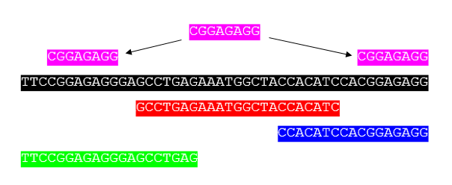
Sequence assembly

Slide 25
Genome Assembly
Contig 1
Contig 2
Contig 3
Sequence Gap
Scaffold
Physical Gap

Slide 26
Genome annotation
Annotation is the addition of information about the predicted sequence features to the flat file of DNA code
Identification of potential coding sequences - CDS
Homology searches to predict function
Other features can be annotated as well
rRNAs
Potential promoters
tRNAs
Small non-coding RNAs
Repeat sequences
Insertion sequences (ISs), transposons, gene fragments
Location of the origin of replication
Determination of the number of bases, genes, and G+C%.

Slide 27


Mapping
Short reads (<200bp) often inefficient de novo assembly
Instead they are mapped against a reference genome
Like assembling a jigsaw puzzle using the image on the lid

Slide 28
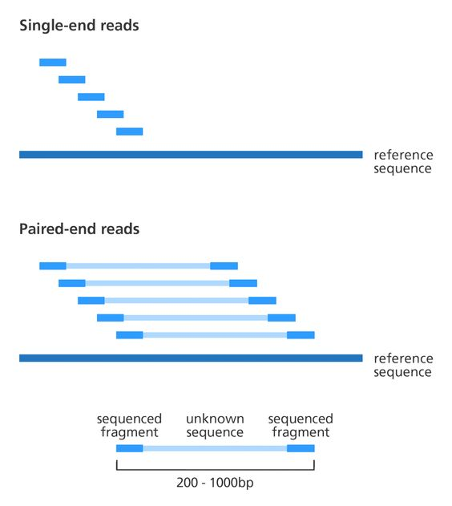

Slide 29
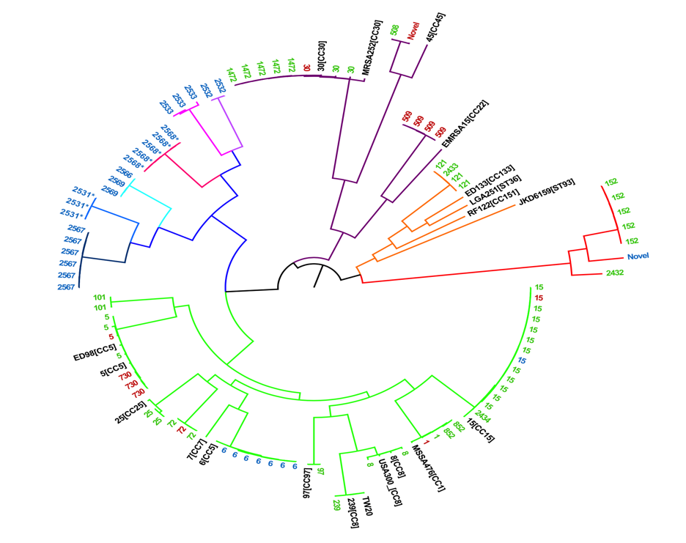
SNP calling
Comparisons between closely related strains allows identification of SNPs that are informative for
Identifying biologically significant changes, e.g. during evolution in lab or patient
Reconstructing phylogenies using neutral changes
ATGTCGAGTGACCAGTGAGTAG
ATGTCGAGTCACCAGTGAGTAG

Slide 30
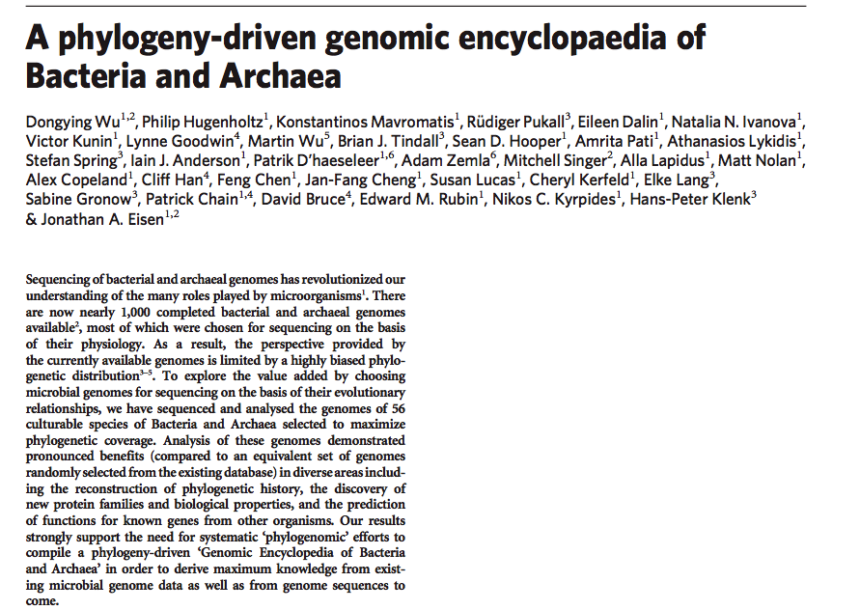
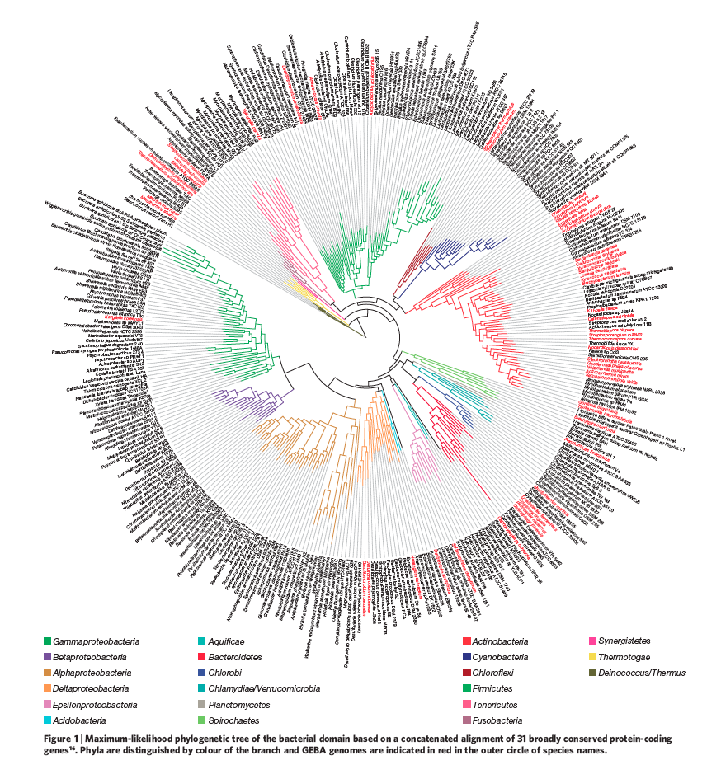
Comprehensive coverage of tree of life

Slide 31
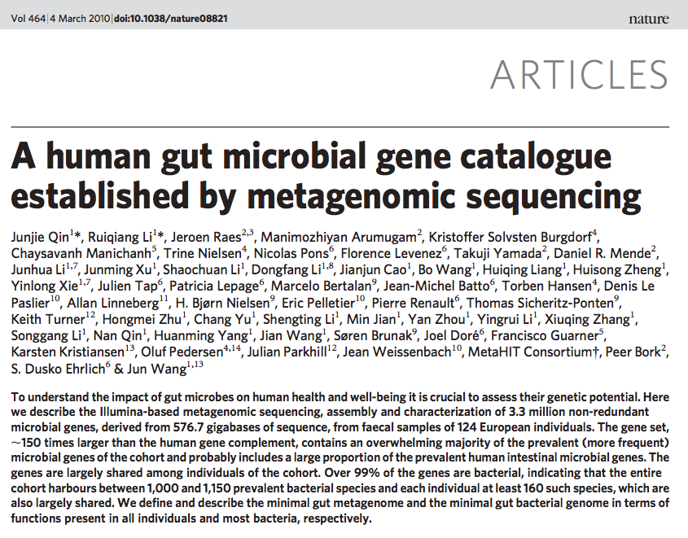
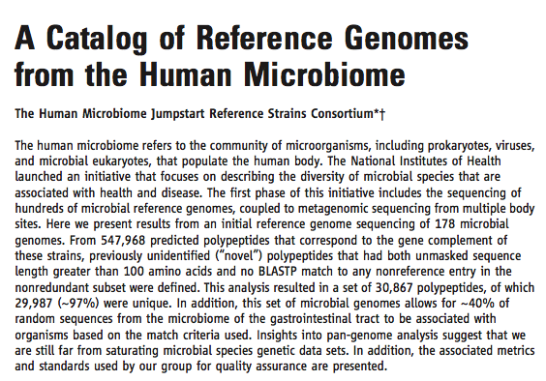
Comprehensive Coverage of Human Microbiome

Slide 32
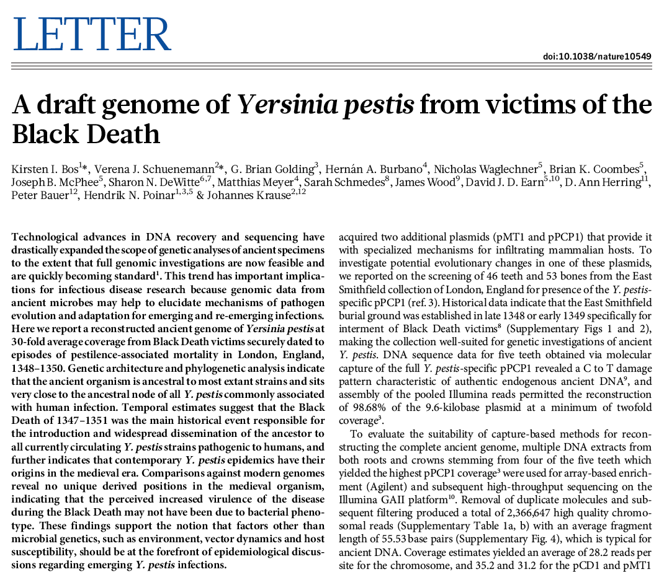

Slide 33
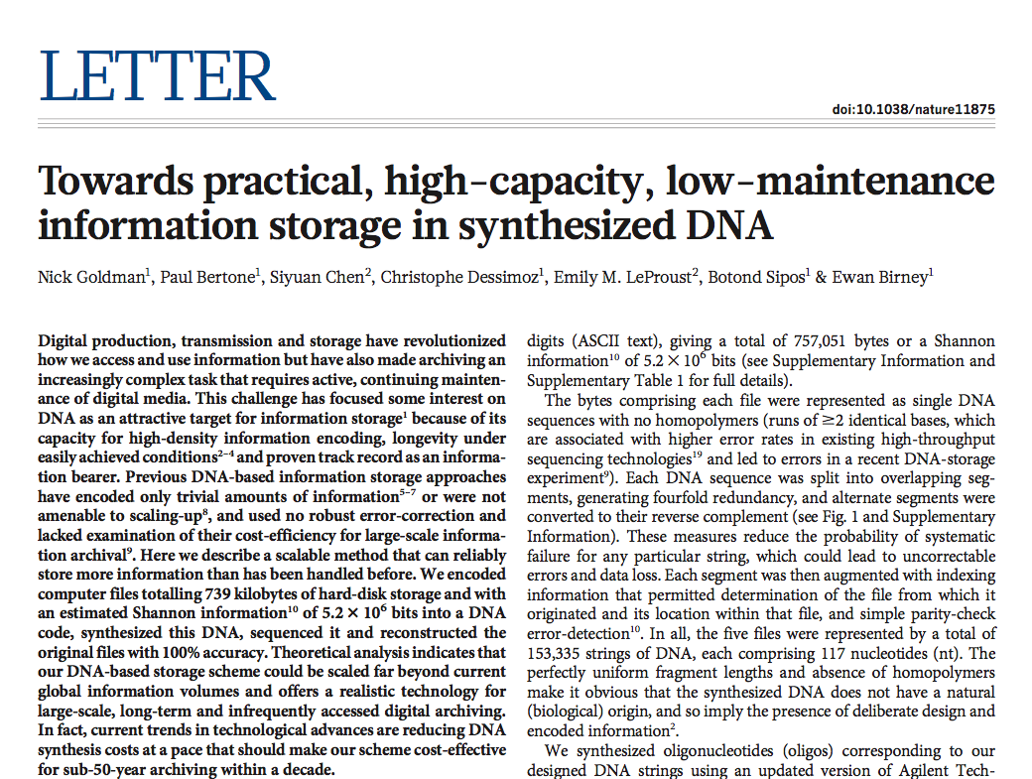

Slide 34
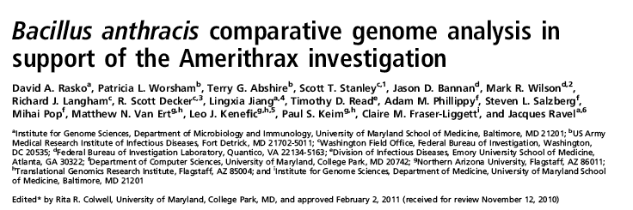

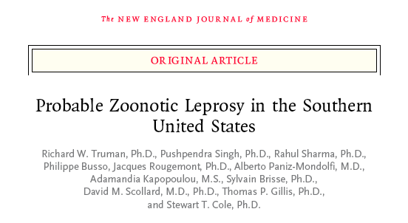
The Birth of Genomic Epidemiology for Bacteria
Notes:
95 & 63 strains

Slide 35

REMEMBER THE OLD GAME OF “TELEPHONE?”

Slide 36
TACGTAGTACGTAACTGCGACGTCTCTGATGCTAGTAATGATGCTCGTTAGCGTTAGTCGTAATCGTGATGCTGTACGTACCGTACGTACGTAGCTGATCTACGTATCGTATCGTCGATCGTAGCTAGCTGCTACGTATCGTCGATCGTAGCTGTAGCTA

Slide 37
TACGTAGTACGTAACTGCGACGTCTCTGATGCTAGTAATGATGCTCGTTAGCGTTAGTCGTAATCGTGATGCTGTACGTAGCGTACGTACGTAGCTGATCTACGTATCGTATCGTCGATCGTAGCTAGCTGCTACGTATCGTCGATCGTAGCTGTAGCTA

Slide 38
TACGTAGTACGTAACTGCGACGTCTCTGATGCTAGTAATGATGCTCGTTAGCGTTAGTCGTAATCGTGATGCTGTACGTAGCGTACGTACGTAGCTGAACTACGTATCGTATCGTCGATCGTAGCTAGCTGCTACGTATCGTCGATCGTAGCTGTAGCTA

Slide 39
TACGTAGTACGTAACTGCGACGTCTCTGATGCTAGTAATGATGCTCGTTAGCGTTAGTCGTAATCGTGATGCTGTACGTAGCGTACGTACGTAGCTGAACTACGTATCGTATCGTCGATCGTATCTAGCTGCTACGTATCGTCGATCGTAGCTGTAGCTA

Slide 40


Slide 41


Slide 42


Slide 43




Genomic Epidemiology

Slide 44
Case study: Acinetobacter baumannii
Gram-negative bacillus
Multi-drug resistant
colistin and tigecycline as reserve agents
moving towards pan-resistance
Associated with
wound infections and ventilator-associated pneumonia
bloodstream infections
returning military personnel from Iraq and Afghanistan
transmission from military to civilian patients

Slide 45
Acinetobacter baumannii: problems
Hard to identify in clinical laboratory
Two related genomospecies 3 and 13TU, (now A. pittii and A. nosocomialis) impossible to distinguish phenotypically
Serial clonal outbreaks identified by PFGE, VNTR and gene-specific assays
BUT mode of spread and transmission chains often uncertain, hindering optimal management of outbreaks and rational design of policies
Mechanism of resistance hard to identify in individual cases
Poor understanding of pathogen biology

Slide 46
2011-2012 Pulsotype 27 Outbreak
First reported case July 2011 (military patient)
Typed by HPA, designated unique pulsotype 27
Outbreak lasted 80 weeks and involved 60 patients, including military and civilian patients
91 isolates from patients and environment genome-sequenced on Illumina MiSeq, including multiples from same patient (different time and body sites)
Genome sequencing revealed that the outbreak strain is distinct from all other well-characterized strains, including strains implicated in previous outbreaks in our local hospitals

Slide 47



Slide 48


Slide 49


Slide 50


Slide 51


